Slide 1
Introduction
Università di Modena e Reggio Emilia

Slide 2
Android timeline
2003: Android Inc. was founded
2005: Google bought Android Inc.
2008: first device with Android OS
2017: Google announced that Google Play would begin to require apps to target Android 8
2021: Google announced new apps will need to target Android 10
Name | Internal codename | Version number(s) | Initial stable release date | Supported (security fixes) | API level
Android Oreo | Oatmeal Cookie | 8.0 | August 21, 2017 | No | 26
 |  | 8.1 | December 5, 2017 | No | 27
Android Pie |  | 9 | August 6, 2018 | Yes | 28
Android 10 | Quince Tart | 10 | September 3, 2019 | Yes | 29
Android 11 | Red Velvet Cake | 11 | September 8, 2020 | Yes | 30
Android 12 | Snow Cone | 12 | October 4, 2021 | Yes | 31
Android 12L | Un­known | Un­known | Q1 2022 | Presupported | 32

Slide 3
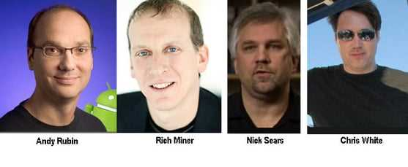
History
Android began in 2003 as a project of the American technology company Android Inc., to develop an operating system for digital cameras.
In 2004 the project changed to become a smartphone operating system. Andy Rubin, Rich Miner, and Chris White
founded Android Inc. for the development of what Rubin called «... mobile devices more aware of the location ……and preferences of their owner» . It was purchased by the American search engine company Google Inc.,
In 2005 at Google, the Android team decided to base their project on Linux, an open-source operating system for personal computers

Slide 4
History
In September 23,2008 Android 1.0 was released, the first commercial version of the software. The first commercially available Android device was the HTC Dream. Android 1.0 incorporated the following features:
Android Market, enabling app downloads and updates via the Market app.
Web browser to show, enlarge and browse complete HTML and XHTML web pages - multiple pages displayed as windows ("tabs"). Camera support - however, this version did not have the ability to change the camera resolution, white balance, quality, etc.
Folders that allow grouping several application icons into a single folder icon on the home screen.
Access web email servers, which support POP3, IMAP4, and SMTP. Sync Gmail with Gmail app.
Sync Google contacts with the People app.
Synchronization of Google Calendar with the Calendar application.
Google Maps with Street View to view maps and satellite images, as well as find local businesses and get directions using GPS.

Slide 5
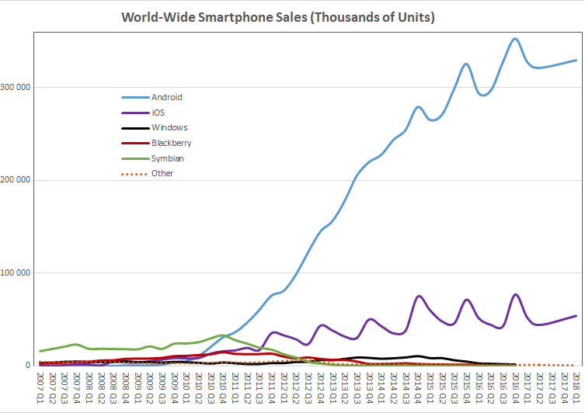
Android stas
Year | Active users
2012 | 0.5 billion
2013 | 0.7 billion
2014 | 1 billion
2015 | 1.4 billion
2016 | 1.7 billion
2017 | 2 billion
2018 | 2.3 billion
2019 | 2.5 billion
2020 | 2.8 billion
https://www.businessofapps.com/data/android-statistics/
https://en.wikipedia.org/wiki/Usage_share_of_operating_systems

Slide 6
Why develop Android app?
Market share
Best-selling OS worldwide on smartphones and tablets
Device compatibility
Low training time
Free and open-source software
Https://source.Android.Com/
Programming languages
You can use Java, Kotlin
Support
Large api

Slide 7
Key features
Linux O.S. Kernel: provide interface with hardware and process control
Run time environment (ART): used to execute applications
(Each app runs in a separate process and ART has control on memory and process management, it could stop or kill processes)
Open source libraries for application development
Pre-installed application: phone, SMS, email, browser, calendar, camera, contacts, alarm clock
Software development kit (SDK): used to create app (including IDE and Documentation)
Application framework to manage system services
User interface framework
Compatibility Definition Document (CDD) and Compatibility Test Suite (CTS): describe the resources required for a devis to support android software

Slide 8
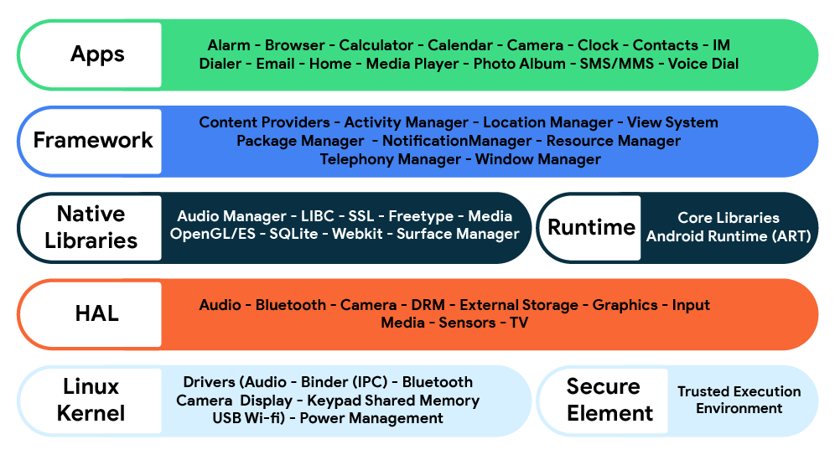
Android Architecture

Slide 9
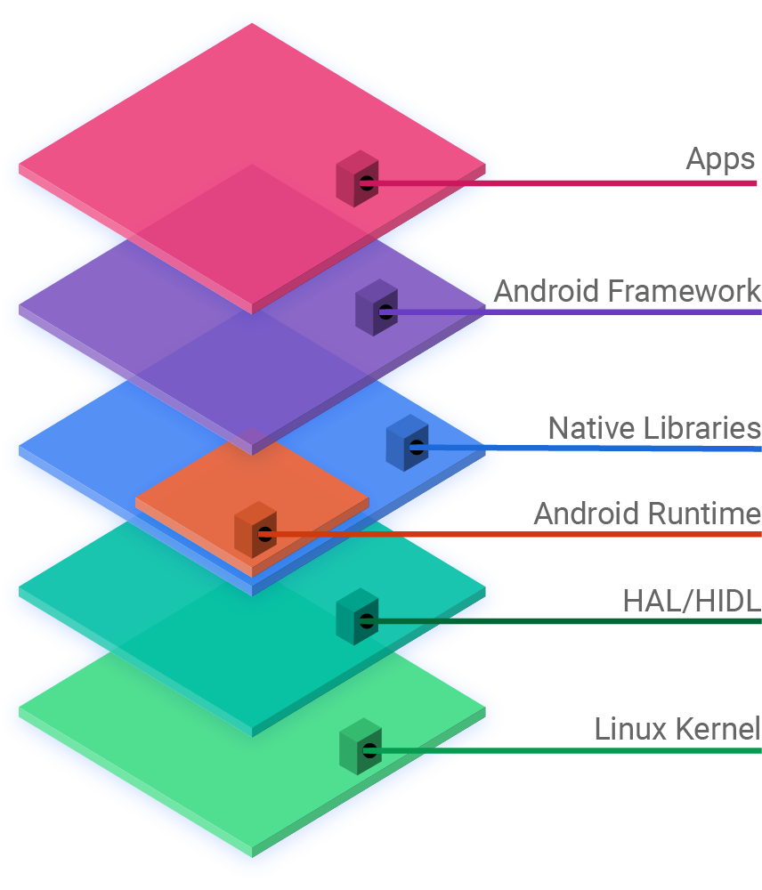
Android Architecture
Android is structured in the form of a software stack
There are 6 principal layer:
Apps: is the top layer, the pre-installed applications like home, contacts, camera, gallery etc. and third parts applications downloaded from the play store like chat applications, games etc. will be installed on this layer only. It runs within the Android run time with the help of the classes and services provided by the application framework.

Slide 10
Android Architecture
Android Framework: Application Framework provides classes and services which are used to create an Android application.

Slide 11
Android Architecture
Native libraries: it concerns libraries C/C++ used by system’s components like:
Surface Manager: module that handle View (graphic component)
Media Framework: handle Codec, useful for acquisition and playing multimedia contents.
SQLite: Database Management System (DBMS) used by Android, is a small and efficient relational DBMS given developer to memorize App’s data.

Slide 12
Android Architecture
Android Runtime: contains components like core libraries and the Dalvik virtual machine(DVM).
Core libraries: includes most of the features provided by the standard java libraries with the addition of specific libraries for android
Dalvik virtual machine: an evolution of Java virtual Machine developed by Google in order to work on device less efficient as phone and to ensure that a device can rum multiple instances efficiently.

Slide 13
Android Architecture
HAL/HIDL: defines a standard interface to be implemented for hardware vendors, allowing Android to be independent of lower-level driver implementations.

Slide 14
Android Architecture
Linux Kernel: Android uses a version of the Linux kernel with a few special additions for a mobile embedded platform. In Linux Kernel each application is binded to a single process.

Slide 15
Android Framework
The Android Framework is a set of services that collectively form the environment in which Android applications run and are managed.
Include key services:
Activity Manager: Controls application lifecycle and activity stack.
Content Providers: Allows applications to publish and share data with other applications.
Resource Manager: Provides access to resources
Notifications Manager: Allows applications to display alerts and notifications to the user.
View System: A set of views used to create application user interfaces.
Package Manager: The system by which applications are able to find out information about other applications currently installed on the device.
Telephony Manager: Provides information to the application about the telephony services available on the device such as status and subscriber information.
Location Manager: Provides access to the location services allowing an application to receive updates about location changes.

Slide 16
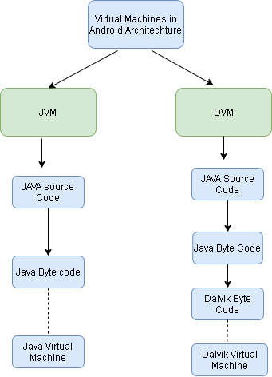
JVM vs Dalvik
Android doesn’t use JVM but use a special VM called DALVIK.
Android devices don’t run .class and .jar files. To improve performance, they use optimized formats.
Android uses DEX Compiler to transform Java Byte code in Dalvik Byte code (.dex)
Since Android 8.0 Dalvik has been replaced by ART (Android Run Time)

Slide 17
Android SDK
Android Software Development Kit contains the libraries and tools you need to develop Android apps
API libraries: one for each Android version
Development tools: Android Studio IDE and other tools (debugger, design tools…)
Android Virtual Device Manager
Emulator: run in AVD
Android support: extra APIs that aren’t available in standard platform
Sample apps: you can find pratical code to help you to use APIs

Slide 18
Android libraries
android.app: Provides access to the application model and is the cornerstone of all Android applications. Contains Activity and Service two of the application core components
android.content: Facilitates content access, publishing and messaging between applications and application components
android.database: Used to access data published by content providers and includes SQLite database management classes.
android.hardware: Presents an API providing access to hardware such as the accelerometer and light sensor.
android.os: Provides applications with access to standard operating system services including messages, system services and inter-process communication.
android.media: Provides classes to enable playback of audio and video.
android.provider: A set of convenience classes that provide access to standard Android content provider databases such as those maintained by the calendar and contact applications.
android.text: Used to render and manipulate text on a device display.
android.widget: A rich collection of pre-built user interface components such as buttons, labels, list views, layout managers, radio buttons etc.
android.view: The fundamental building blocks of application user interfaces.
android.util: A set of utility classes for performing tasks such as string and number conversion, XML handling and date and time manipulation.

